Slide 1


POPL PROJECT GROUP 3
Comparative Analysis of Node.js and Rust Backends for a RESTful Notes Web Application
PRESENTED BY
Harshvardhan Birla
Himanshu Singh
Shashank Rana
Aditya Kulkarni

Slide 2


MICROSERVICE FRAMEWORK
In order to do a comparative analysis of microservices, we will be following the Express.JS framework which is a Javascript based microservice framework.
The microservice will consist of a RESTful API which will be used to communicate with the database.
The database we have chosen is MongoDB.

Slide 3
Testbed
The testbed is a Notes Web Application.
It will consist of multiple testcases to test the various microservices implemented -
Sign Up user
Login
Create Note (POST request)
Read Note (GET request)
Update Note (PUT request)
Delete Note (DELETE request)

Slide 4
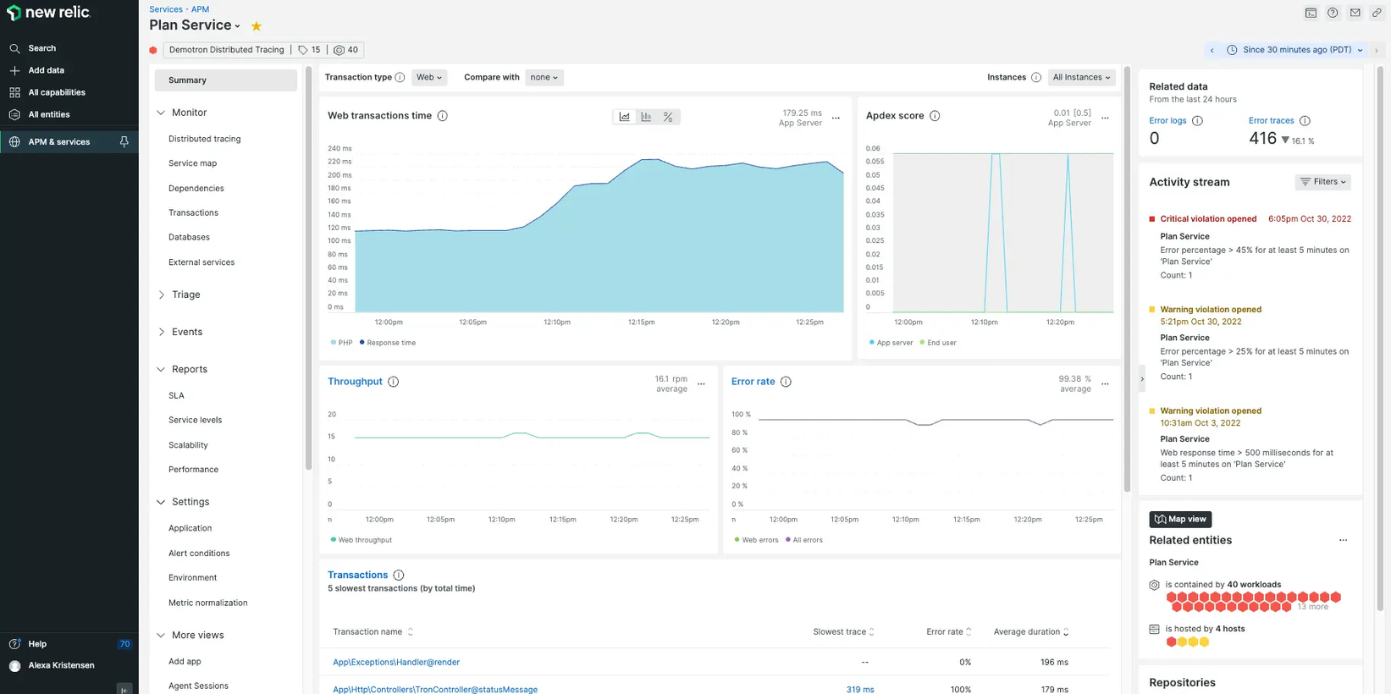
Profiling Tool

Slide 5
Special Testcase
A special test case that we will try to implement is calling the API through the application a large number of times in a loop.
This will lead to a heap overflow in Javascript but we expect that Rust will prevent this due to its strong memory management techniques that prevent any buffer overflow exploitations.

Slide 6
THANK YOU!

